Slide 1
Florida Ethics Overview & Update
Soil and Water Conservation Districts
August 14, 2025
Gray Schafer
Assistant General Counsel
State of Florida Commission on Ethics

Slide 2
About the Commission on Ethics
The Commission is charged with administering:
  The Sunshine Amendment
  (Article II, Section 8, Florida Constitution)
  The Code of Ethics for Public Officers and Employees
  (Part III of Chapter 112, Florida Statutes)
There are nine seats on the Commission
  Appointments by the Governor (5), Senate President (2), and Speaker of the House (2)
  Appointments are split between the two political parties

Slide 3
About the Opinions Process
The three ways the Commission on Ethics provide ethics guidance
Over the phone
  Uncomplicated facts and plenty of precedent in formal opinions
  Ethics Hotline: (850) 488-7864
Guidance Letters
  Complicated facts, but plenty of precedent in formal opinions
  Written by legal staff of the Commission on Ethics
  Email: stillman.kerrie@leg.state.fl.us
Formal Opinions
  Guidance issued by majority vote of the Commission
  Binding advice on the requestor

Slide 4
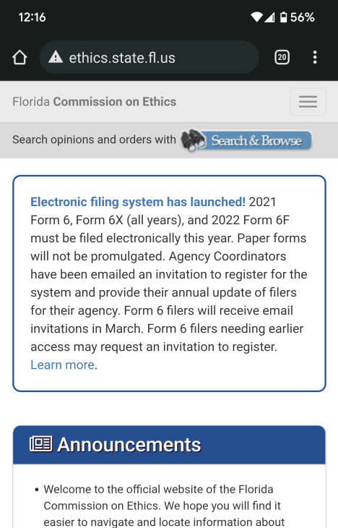
About the Commission’s Website
https://ethics.state.fl.us
Search for Formal Opinions
View Form 6 Submissions
Keyword search to perform research.
Search and view all Form 6 filings by public officers and candidates.
Download Forms
Commission Meeting Materials
All forms and instructions available to download and print.
View agenda and meeting materials.
Ethics Training
Complaint Process Info
View videos on
various ethics topics.
Review information about filing a complaint.

Slide 5
About the Complaint Process
…
Complaints may be filed by anyone
Must use the official complaint form (CE Form 50)
  To be investigated, an allegation must be based on personal knowledge or information other than hearsay
All complaints must be sworn
All complaints are confidential until:
  The matter is dismissed;
  Probable cause is found; or
  Confidentiality is waived.
The Commission can accept referrals from certain agencies

Slide 6
Misuse of Public Position –
Sections 112.313(6) and 112.313(8)
These two prohibitions are applicable to all public officers and employees—State and local—in Florida
Section 112.313(6) – A public officer or public employee may not:
  “Corruptly” use or attempt to use;
  His or her public position or resources;
  To obtain a special benefit for privilege;
  For oneself or others
Section 112.313(8) – May not disclose information learned through one’s public position that is not available to the public

Slide 7
The Constitutional “Abuse” Prohibition–
Article II, Section 8(h)(2), Fla. Const.
Also applies to all public officers and employees in Florida, both State and local
Applies if one intentionally “abuses” their public position to obtain a “disproportionate benefit” for themselves, a spouse or child, an employer, or an affiliated business
“Intent” is an element – Must act with a “wrongful intent” to obtain a privilege, benefit, or exemption that is “inconsistent with the proper performance” of one’s public duties (CEO 21-01 and CEO 19-23)

Slide 8
Anti-Nepotism –
Section 112.3135
Applies if one appoints, employs, promotes, or advances a relative
  Also applies if one “advocates” for a relative’s appointment, employment, promotion or advancement
A violation can be found even if the public officer did not participate in the actual decision/vote to hire their relative
  Statute is triggered if the collegial body on which the officer serves made the decision
Will not apply to independent contractors

Slide 9
Dual Office-Holding and
Additional Public Employment
Section 112.313(10) – If a public officer is employed by an agency, he cannot serve on that agency’s governing board
Section 112.3125 – Elected public officers may not accept outside public employment without complying with some additional steps
  Position must be publicly advertised
  Position must already be in existence
  Public officer must be subject to same hiring criteria as anyone else, and meet or exceed that criteria

Slide 10
Conflicts of Interest –
“Doing Business” with your agency
Section 112.313(3) applies to public officers—or immediate family members—owning or serving as officers in a business
Section 112.313(3) has two parts:
  Cannot purchase for your District any goods/services from such a business;
  Cannot have such a business sell goods/services to your District
Grandfathering is possible!

Slide 11
Conflicts of Interest –
Conflicting Employment/Contractual Relationships
Section 112.313(7)(a) applies if you are an employee of—or in contract with—a business or agency
The first part of Section 112.313(7)(a) prohibits you from:
1. Having an employment or contractual relationship with a business entity or agency;
2. When that entity/agency is being regulated by or is doing business with your District

Slide 12
Conflicts of Interest –
Conflicting Employment/Contractual Relationships
The second part of Section 112.313(7)(a) prohibits you from having an employment or contractual relationship that either:
  Creates a continuing or frequently recurring conflict with the performance of your public duties; or
  Impedes your ability to fully and faithfully discharge your public duties

Slide 13
Statutory Exemptions to
Sections 112.313(3) and (7)(a)
The majority of exemptions are laid out in Section 112.313(12)
They include:
  Sole Source of Supply;
  Emergency Purchases;
  Purchases made through sealed, competitive bidding;
  When total amount of annual business is less than $500
But…complying with the voting conflict statute will not cure a violation of Sections 112.313(3) or 112.313(7)(a)

Slide 14
Voting Conflicts – Section 112.3143
The portion of the voting conflict statute applicable to local officers is Section 112.3143(3)
Conflicts hinge upon “special private gain or loss” (i.e., an economic benefit or harm
Two types of voting conflicts
  May not vote on measure bringing “special private gain or loss” to yourself; and
  May not vote on measure which you know will bring “special private gain or loss” to a principal, relative, or business associate

Slide 15
Voting Conflicts –
Three Considerations
What is the size of the class that is going to be affected by this vote?
Is the possibility of an economic effect remote or speculative?
Is this merely a preliminary or procedural measure which will have no substantive effect?
Contact the Commission for further information about these considerations

Slide 16
Voting Conflicts –
How to respond
There are three steps to take when a voting conflict is presented:
  Abstain from the vote;
  Disclose the conflict prior to the vote; and
  File the Form 8B within 15 days of the vote
The Code of Ethics does not require you to leave the room
Be as thorough as possible when completing the Form 8B

Slide 17
State Bribery Statutes –
When Something is given in Exchange
Section 112.313(2) – A public officer or employee may not solicit or accept anything of value in exchange for taking some public action
  Although there must be an agreement by both parties on what is expected
Section 112.313(4) – A public officer or employee may not accept a gift if they know or reasonably should know it is being given to influence public action
  Covers gifts accepted by spouse or children as well

Slide 18
The Gift Law – Section 112.3148
Who does it apply to?
  Local officers who have to file a financial disclosure form, among others
What is a gift?
  Anything of value (meals, drinks, use of property, tickets, personal services, transportation/lodging, etc.)
What is a lobbyist for purposes of Section 112.3148?
  An individual who for compensation—during the past 12 months—has sought to influence the decisions made by your agency

Slide 19
The Gift Law – What is prohibited?
You cannot solicit a gift of any amount from a lobbyist, principal of a lobbyist, or vendor of your agency
You cannot accept a gift of over $100 from a lobbyist, principal of a lobbyist, or vendor of your agency
You cannot solicit or accept a gift of any amount from a political committee

Slide 20
The Gift Law – What is allowed?
Gifts from “relatives”
  Can accept gifts from relatives of any amount
  No reporting requirements
Gifts from friends in the community
  Can accept gifts of any amount coming from nonprohibited sources (i.e., those not vendors/lobbyists/principals of lobbyists) assuming they are not bribes
  Make sure to report gifts of over $100 on a quarterly Form 9

Slide 21
Financial Disclosure –
Section 112.3145
Soil and Water Control District Supervisors file the CE Form 1
  Section 112.3145(1)(a)1. requires local elected officers to file the Form 1
File by July 1, with a grace period until September 1
Any corrections made prior to September 1 count as part of original filing
$25 per day fine if filed after September 1

Slide 22
Post Office Holding Restrictions –
Statutory Restrictions
Section 112.313(8) – Cannot share confidential information learned in your public position
Section 112.313(14) – Elected local officers are barred for two years from:
  Representing another person or entity;
  For compensation;
  Before their former “government body or agency”
Although contacting your former agency on your own behalf will not violate the prohibition

Slide 23
Thank you
Gray Schafer
Assistant General Counsel
schafer.grayden@leg.state.fl.us
(850) 488-7864

